Slide 1
Speed

Slide 3
Speed of a body gives us an idea of how slow and fast that body is moving.
Definition: The rate of distance travelled by the body in unit time interval.

Slide 4
Speed of a body is = distance travelled / time taken.
v = s/t
Where v = speed,
s = distance travelled,
t = time taken.
unit of speed is m/s

Slide 5
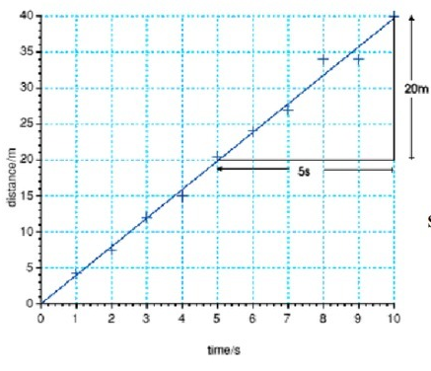
Uniform Speed: When a body covers equal distances in equal intervals of time (however small the time intervals may be), the body is said to be moving with a uniform speed.

Slide 6
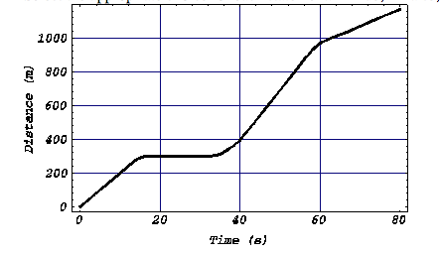
Non-Uniform Speed: When a body covers unequal distances in equal intervals of time, the body is said to be moving with a non-uniform speed.

Slide 7
Average Speed: When a body is moving with a variable speed, then the average speed of the body is defined as the ratio of total distance travelled by the body to the total time taken.
Average speed = Total distance travelled
-------------------------------
Total time taken

Slide 8
1. A cyclist covers 140 km in 7 hours. Express the speed of the cyclist in km/hr.
2. Indian express moves at a uniform speed of 240 km/hr. How long will it take to cover 30 km?
3. Express 18 km/hr into m/s.

